Slide 1
Knauss to NOAA: How the Knauss Fellowship can jump start your NOAA career
Nicolás Alvarado, PhD
Office of Coast Survey
National Ocean Service
National Oceanic & Atmospheric administration

Slide 2
Path to NOAA-this is my journey…
Informal setting / Questions? Feel free to ask.
Starting point → Graduate school
Doctorate
International student
Knauss fellowship
What is it?
International student (F-1 visa OPT)
Opportunities
NOAA
Oceanic and Atmospheric Research (OAR)
Office of Ocean Exploration (OE)
National Marine Fisheries Service (NMFS)
Protected Resources (PRD)
Southeast Regional Office (SERO)
Sustainable Fisheries Highly Migratory Species (HMS)
National Ocean Service (NOS)
Office of Coast Survey (OCS)
Why NOAA?
Why Knauss Fellowship?
Texas Sea Grant candidates

Slide 3

Education/Career Path
Canada
BSc Honors Chemistry
MSc Groundwater Geochemistry
United States of America (1999-present)
PhD Oceanography from Texas A&M University (2004)
Knauss Sea Grant Fellowship (2004-2005) [SAB]
Office of Ocean Exploration (2005-2012) [OAR]
Office of Protected Resources (2012-2016) [NMFS]
Office of Sustainable Fisheries (2016-2021) [NMFS]
Office of Coast Survey (2021-present) [NOS]

Slide 4
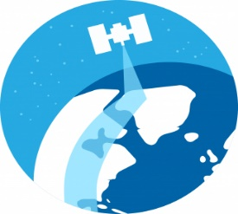
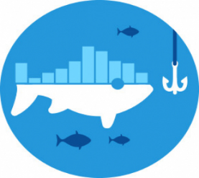

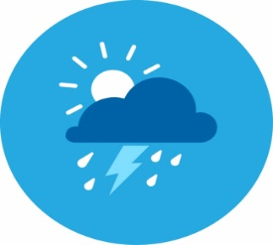
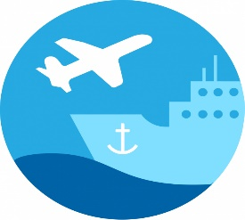

National Oceanic & Atmospheric Administration
NOAA
National Environmental Satellite, Data, & Information Service
[NESDIS]
National Marine Fisheries Service
[NMFS]
National Ocean Service
[NOS]
National Weather Service
[NWS]
Office of Marine & Aviation Operations NOAA Corps
[OMAO]
Office Oceanic & Atmospheric Research
[OAR]

Slide 5
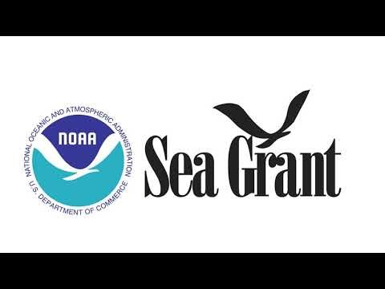
What is it?

Slide 6
Knauss Fellowship
https://seagrant.noaa.gov/Knauss-Fellowship-Program
Challenges of the fellowship as an International student
F-1 Student visa status → Optional Practical Training (OPT)
Optional Practical Training (OPT) provides F-1 students an opportunity to gain practical work experience in the US, in a field directly related to their academic program. A foreign student is eligible to participate in OPT for up to 12 months per educational level.
Some hosts are not possible
Think outside the box!
National Science Foundation
NOAA Science Advisory Board
NOAA Ocean Exploration

Slide 7
Knauss Fellowship
NOAA Science Advisory Board
Assisted the Executive Director of the NOAA Science Advisory Board (SAB)
SAB activities and advice provide necessary input to ensure that NOAA science programs are of the highest quality and provide optimal support to resource management, and environmental assessment and prediction.
Assists NOAA in maintaining a complete and accurate understanding of scientific issues critical to the agency’s missions.
SAB is composed of eminent scientists, engineers, resource managers and educators, the diverse membership of the Board assures expertise reflecting the full breadth of NOAA’s responsibilities, as well as the ethnic and gender diversity of the United States.
Dr. Jake Rice, Chief Scientist, Canadian Department of Fisheries and Oceans
Served as the liaison between the NOAA Administrator/HQ, the NOAA Line Offices, and the NOAA Science Advisory Board.
Ocean Exploration Gulf of Alaska Seamount Expedition
28 days at sea
Life after the Knauss fellowship…

Slide 8
National Oceanic & Atmospheric Administration
NOAA
National Environmental Satellite, Data, & Information Service
[NESDIS]
National Marine Fisheries Service
[NMFS]
National Ocean Service
[NOS]
National Weather Service
[NWS]
Office of Marine & Aviation Operations NOAA Corps
[OMAO]
Office Oceanic & Atmospheric Research
[OAR]

Slide 9
Ocean Exploration [OAR]
Grants Manager – 80+ projects processed over $44 million in federal awards
Ocean Exploration
Marine Archaeology
Education & Outreach
Travel opportunities
National & International
Guam/Palau, Cayman Islands, Bermuda, Bahamas, Gulf of Mexico
Chaired sessions at National Conferences (AGU/ASLO/Ocean Sciences)
Networking opportunities
Within NOAA
Details
Program Coordination Office (PCO)
Academia

Slide 10
National Oceanic & Atmospheric Administration
NOAA
National Environmental Satellite, Data, & Information Service
[NESDIS]
National Marine Fisheries Service
[NMFS]
National Ocean Service
[NOS]
National Weather Service
[NWS]
Office of Marine & Aviation Operations NOAA Corps
[OMAO]
Office Oceanic & Atmospheric Research
[OAR]

Slide 11
Protected Resources [NMFS]
Endangered Species Act (ESA) Consultation Biologist
Sea turtles/Gulf Sturgeon/Marine Mammals and their Critical Habitat
Tracked and monitored 77 Deepwater Horizon Oil Spill ESA formal and informal consultations.
Project funding estimated at $563.6 million.
Artificial Reefs/Boat ramps/Fishing Piers
Sinking a 371-foot long ship named The Kraken (2017) - 67 miles south-southeast of Galveston, Texas within an 80-acre permitted reef site, in waters that are approximately 135 feet deep.
Oceanic Fish Restoration Program
90 days to complete formal consultation and 45 days to provide a Biological Opinion/135 days].
Various stakeholders
NOAA Restoration Center
Gulf of Mexico States
Non-Governmental Organizations (e.g., National Fish & Wildlife Foundation)
Received 2 ERT Award for Exemplary Service and Commitment to NOAA and ERT in support of the NOAA Fisheries Office of Habitat Conservation Contract (’14, ’15).

Slide 12
Southeast Regional Office [NMFS]
SERO directorate 7 months for 3 task managers
Directorate, Senior Advisor to the Regional Administrator
Catalogued existing responses and identified needed programmatic disaster response protocols and policies to prepare SERO to respond to large-scale disasters (ORR)
NEPA Coordinator
Worked with SERO management to ensure policies and programs were coordinated across activities and offices. Coordinated internal and external engagement in restoration projects (Tracked and monitored NEPA compliance for SERO)
GoM Ecosystem Restoration & Environmental Compliance Coordinator
Prepared SERO for the increased regulatory workload related to new Gulf restoration projects funded thru NRDA, RESTORE Act, NFWF, GoM Energy Security Act.
Received ERT Award for Leadership and Technical Expertise to NOAA and ERT in support of the NOAA Fisheries Office of Habitat Conservation Contract (’16).

Slide 13
Highly Migratory Species [NMFS]
NOAA Fisheries manages HMS fisheries—tunas, sharks, swordfish, and billfish—in U.S. Atlantic Ocean, Gulf of Mexico, and Caribbean waters.
Highly migratory species (HMS) travel long distances and often cross domestic and international boundaries
Developed and implemented fishery management plans in cooperation with the HMS advisory panel.
Authored & led regulatory amendment to increase SWO & SHK fishing in the Caribbean and standardizing regulatory framework in 3 regions. “Atlantic Highly Migratory Species; Modify North Atlantic Swordfish and Shark Retention Limits for Certain Permit Holders and Add Inseason Adjustment Authorization”
Assisted in 4 fishery management amendments
Monitor commercial and recreational catches to ensure compliance with domestic and international quotas and/or catch limits.
ESA compliance for pelagic longline fishery.
Office of Law Enforcement (OLE)

Slide 14
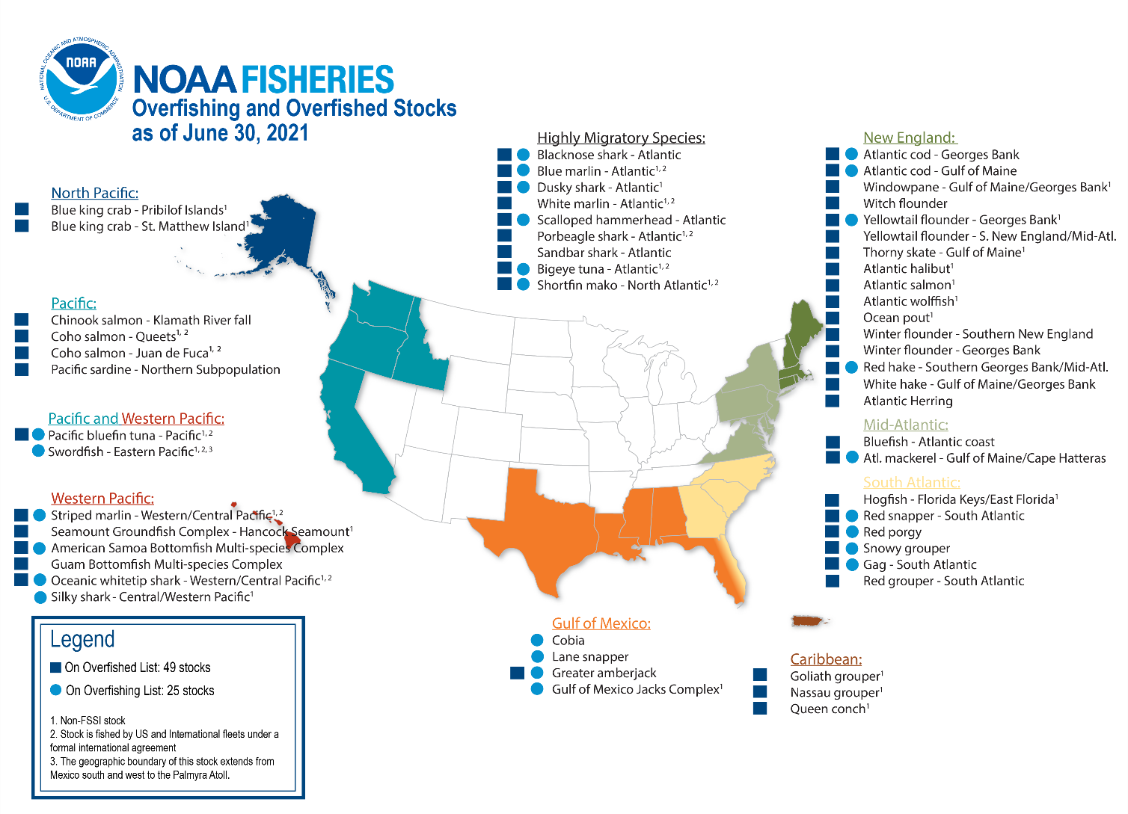
NMFS Status of the Stock

Slide 15
National Oceanic & Atmospheric Administration
NOAA
National Environmental Satellite, Data, & Information Service
[NESDIS]
National Marine Fisheries Service
[NMFS]
National Ocean Service
[NOS]
National Weather Service
[NWS]
Office of Marine & Aviation Operations NOAA Corps
[OMAO]
Office Oceanic & Atmospheric Research
[OAR]

Slide 16
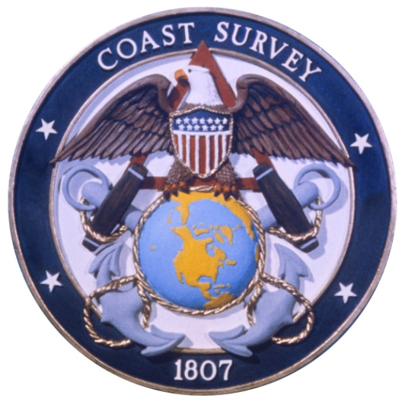
Who is Coast Survey?
First science agency of the U.S.
Formed in 1807
Responsible for surveying 3.4 million square nautical miles
Prepares and maintains 1,000 nautical charts
Responds to disasters and other emergencies
Develops hydrodynamic models to support coastal management

Slide 17
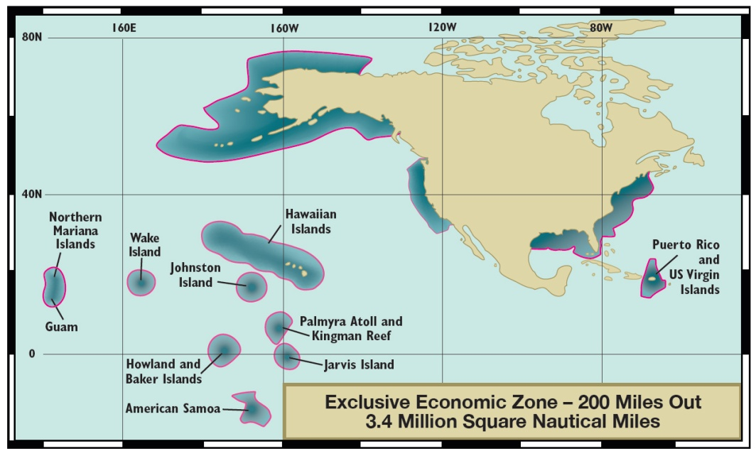
Scope of coverage
U.S. marine transportation system:
95,000 miles of coastline
25,000 miles of navigable channels

Slide 18
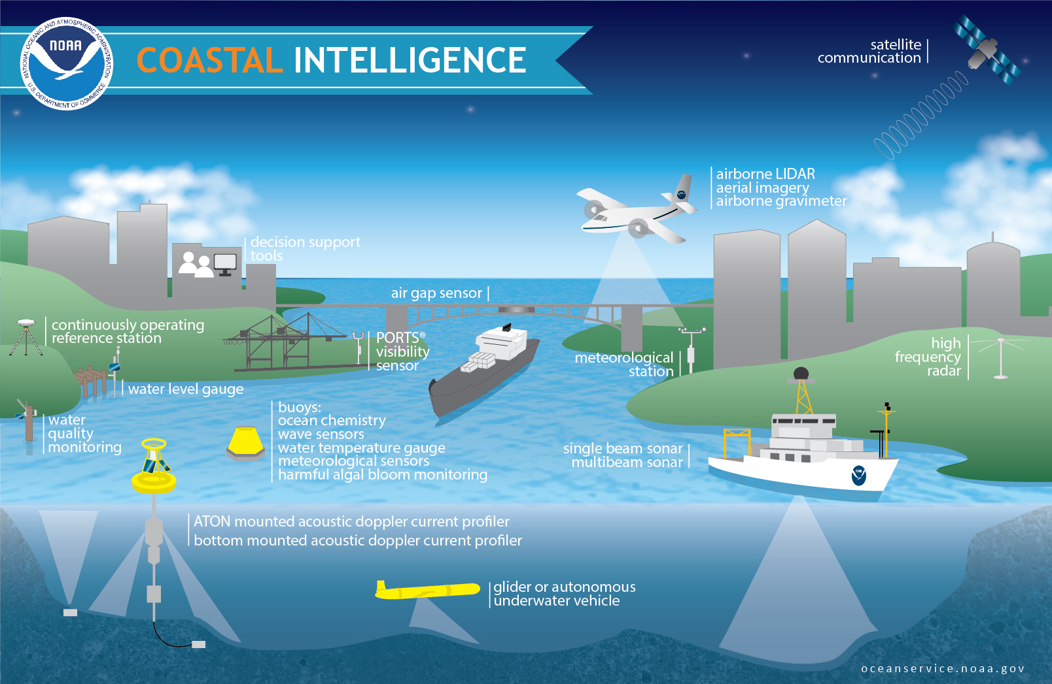
Coastal intelligence provides timely, actionable information developed from reliable and authoritative science to provide insight into present and future conditions in the coastal zone.
Notes:
Coastal intelligence provides timely, actionable information developed from reliable and authoritative science to provide insight into present and future conditions in the ocean and in coastal areas. People in the maritime community rely on coastal intelligence for a range of decisions, from how much cargo to load on a ship to choosing the most efficient and safest route between two waterborne points.
NOAA delivers data from observations and surveys, layered upon prediction models and topography/bathymetry maps, coupled with aerial and satellite imagery and continuous weather conditions. These layers of information describe and inform decisions that affect the marine transportation system, public safety, coastal community resilience, our economy, and sustainable use of the environment.
But the need for timely and accurate data doesn’t just end at the coast….NOAA also delivers data that reaches beyond the coast into the heart of the country including weather data and forecasts and the national spatial reference system that enables GPS.
This intelligence data and its integration is the foundation of precision navigation.

Slide 19
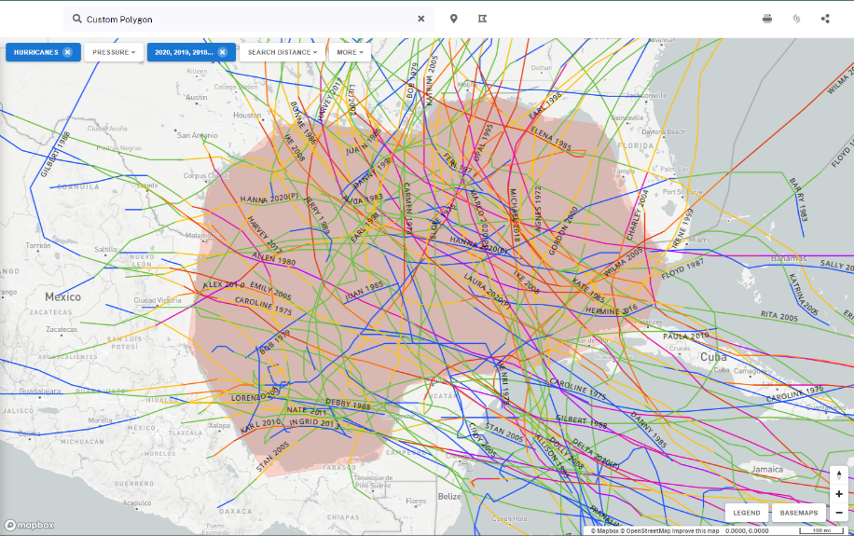
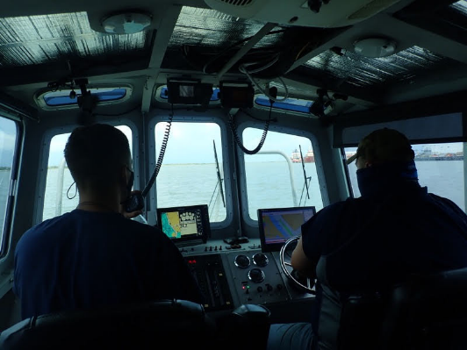
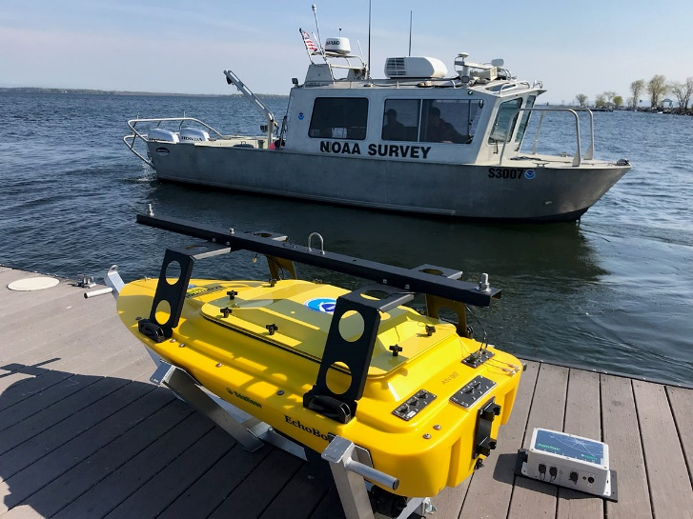
Navigation Manager
Help identify navigational challenges facing the marine transportation system, and provide the resources and services that promote safe and efficient navigation.
NOS Hurricane Preparedness, Response, and Recovery
Speeding the re-opening of ports and protecting lives
Navigation Response Teams
U.S. Coast Guard
U.S. Army Corps of Engineers
State & Local governments
Local stakeholders/partners
NowCoast
Outreach and Education

Slide 20
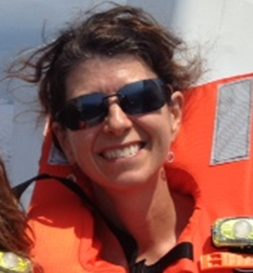
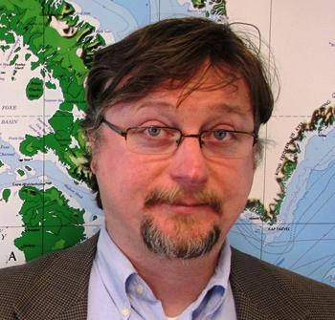
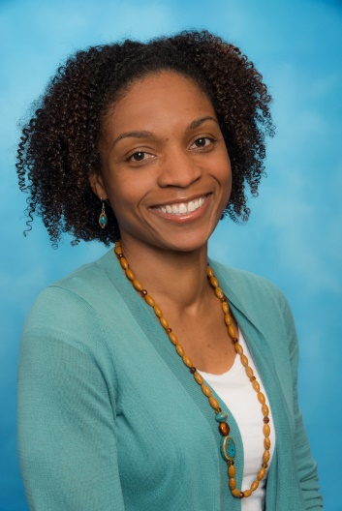
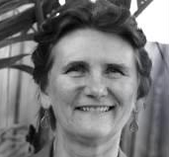
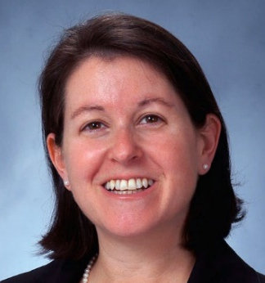

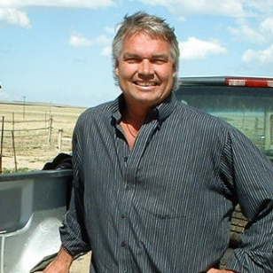
What made you pursue a career at NOAA?
Fellow Graduate Student & Former Knauss fellow
Beth Lumsden (Marine Biologist, PIFSC)
Alternative to pursuing academia
Postponing or choosing a different path?
Paying it forward
Dwight Gledhill (’05*), Deputy Director for NOAA OAP
Where can Knauss take you?
Dr. Letise LaFeir (‘06), NOAA Senior Advisor
Dr. Bonnie J. Ponwith (’98*), NMFS SEFSC Director
Andy Oliver (‘96), Professional Staffer for Congress (NJ)
Dr. Pamela Plotkin (‘94*), Texas Sea Grant Director
Dr. Russell Callender (’92*) Washington Sea Grant Director, (former) NOS Assistant Administrator
Steve Olson (’87*), American Zoological Association Senior Vice President, Government Affairs
* Texas Sea Grant Knauss Fellows

Slide 21
National Oceanic & Atmospheric Administration
What are the Benefits of working at NOAA?
NOAA
National Environmental Satellite, Data, & Information Service
[NESDIS]
National Marine Fisheries Service
[NMFS]
National Ocean Service
[NOS]
National Weather Service
[NWS]
Office of Marine & Aviation Operations NOAA Corps
[OMAO]
Office Oceanic & Atmospheric Research
[OAR]

Slide 22
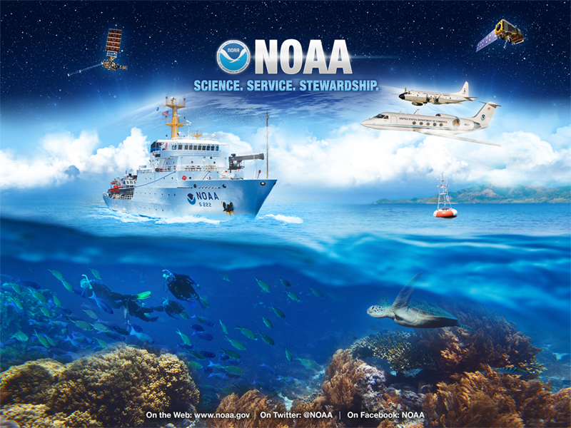

Slide 23
Take-aways
Start early
Reach out to previous year’s fellow
Talk to your local Sea Grant
International Students - OPT
Nicolas.Alvarado@noaa.gov

Slide 24
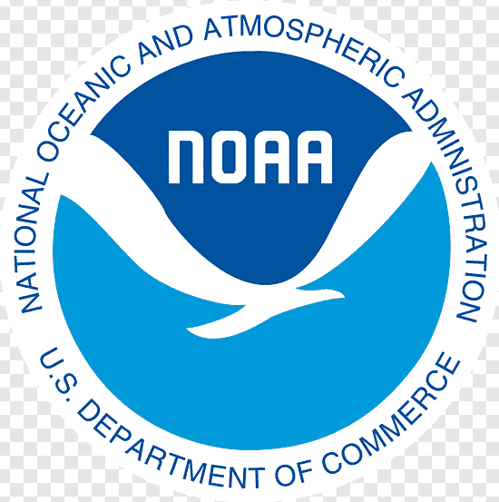
What will your journey look like?

Slide 25
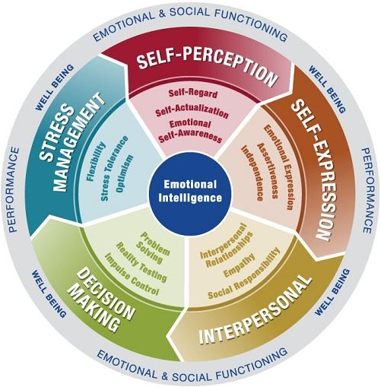
What skill set (hard or soft) did you wish you had prior to starting with NOAA?
Emotional Intelligence (EI) (Psychology of Success) - is the ability to recognize and understand your own emotions and the emotions of others, and to use this awareness to effectively manage your behavior and relationships.
Fixed mindset vs. Growth mindset

